Slide 1
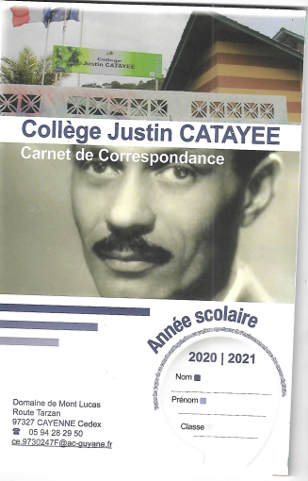
The use of the correspondance booklet The absences

Slide 2
The use of the correspondance booklet The delays

Slide 3
The use of the correspondance booklet The correspondance

Slide 4
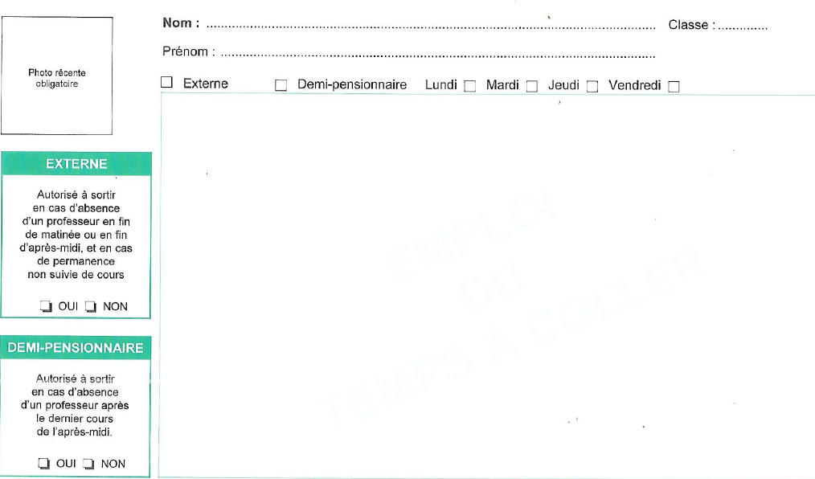
The use of the correspondance booklet The correspondance

